Slide 1
BASIC QUANTUM THEORY Lecture 3: Modern Atomic Theory
Learning Outcomes
By the end of this session, you are able to:
Describe the main features of the quantum mechanical picture of the atom.
Describe the four quantum numbers, and give possible combinations of their values for specific atomic orbitals
Describe the shapes of orbitals and recall the usual order of their relative energies
Write the electron configurations of atoms
Relate the electron configuration of an atom to its position in the periodic table

Slide 2
Wave Mechanical Model of the Atom
Experiments later showed that electrons could be treated as waves.
(just as light energy could be treated as particles)
Electrons have both wave and matter properties
Electrons can be at a variety of specific energy levels in an atom-Energy levels are called orbits
De-Broglie proposed that electron had both wave and matter properties
Heisenberg
Werner Heisenberg in 1927 developed the concept of the Uncertainty Principle.
Heisenberg uncertainty principle states that we cannot know both the position and the momentum of an electron at the same time.
Therefore, we do not know the exact path of the electron in an orbital.

Slide 3
The Quantum-Mechanical Model of the Atom
The quantum mechanical model treats electrons as waves and uses wave mathematics to calculate probability densities of finding the electron in a particular region in the atom
Schrödinger Wave Equation
can only be solved for simple systems, but approximated for others
Erwin Schrödinger applied the mathematics of probability and the ideas of quantitization to the physics equations that describe waves – resulting in an equation that predicts the probability of finding an electron with a particular amount of energy at a particular location in the atom.

Slide 4
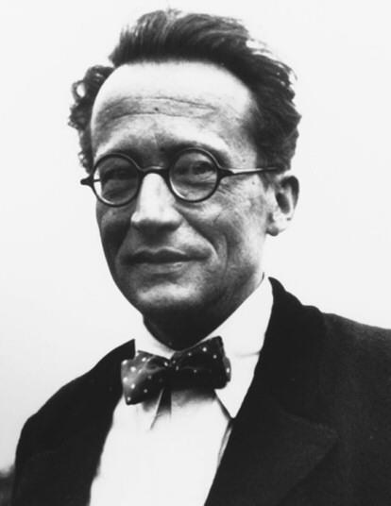
The Quantum-Mechanical Model of the Atom
Erwin Schrödinger
Proposed that electrons move around the nucleus in standing waves.
Each orbit represents some whole number multiple of a wavelength.
Schrodinger analyzed the hydrogen data based on the assumption that the electrons behaved as standing waves.

Slide 5
Schrodinger’s equation takes into account:
The position of the electron in 3D space (its x, y, z coordinates).
Potential energy of the atom due to the attraction between electrons and protons.
Kinetic energy of the electron.
Each solution to Schrodinger’s equation describes a specific wave function (ψ) /orbital.
The square of a wave function, (ψ)², generates a probability distribution for an electron in that orbital.
Probability_{(x,y,z)}$∝$| ѱ_{(x,y,z)}|²
Also called an electron density map for a given orbital.

Slide 6
Ĥψ = Eψ
Ĥ is operator called the Hamiltonian operator.
(represent the general form of the kinetic and potential energies of the system).
E = is the numerical value of the energy for any particular ѱ.

Slide 7
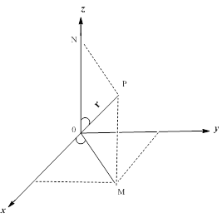
QuantumNumbers from Hydrogen Equations The hydrogen atom solution requires finding solutions to the separated equations which obey the constraints on the wave function. The solution to the radial equation can exist only when a constant which arises in the solution is restricted to integer values. This gives the principal quantum number
Similarly, a constant arises in the colatitude equation which gives the orbital quantum number:
$$θ$$
$$φ$$
Finally, constraints on the azimuthal equation give what is called the magnetic quantum number:

Slide 8
Potential energy =- e² / r
r = ( x²+y²+z²)^{1/2}
r = 0 → ∞ ; θ = 0 → π ; ϕ = 0 → 2π
z = r cos θ; x = r sin θ cos ϕ; y = r sin θ sin ϕ
ѱ_{nlml}= [N][R_{nl}(r)][ϕ_{lml}( xr ,yr ,zr ) ] (angular par)
R_{nl}(r)|² = gives the probability of finding the electron any distance ( r ) from the nucleus.
The two quantum numbers n and l are associated with the radial part of the wave function .
(Radial part).

Slide 10
Orbitals
The result is a map of regions in the atom that have a particular probability for finding the electron.
Orbitals are regions in space where an electron is likely to be found.
90% of the time the electron is within the boundaries described by the electron density map.
The exact path of an electron in a given orbital is not known!
Schrodinger’s equation allows us to describe the energy, size, and electron density maps for orbitals.
The lowest energy solution for an electron in a hydrogen atom describes what is known as the 1s orbital.

Slide 11
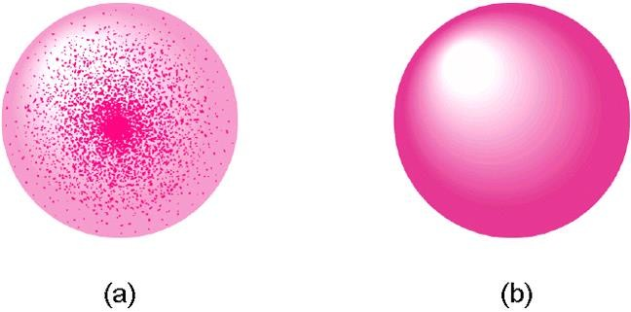
Orbitals are defined by three integer terms that are added to the wave equation to quantize it - these are called the quantum numbers
Each electron also has a fourth quantum number to represent the direction of spin.
A given orbital can be described by a set of 4 quantum numbers:
Principal quantum number ( n )
Angular momentum quantum number ( l )
Magnetic quantum number (m_{l})
Spin quantum number (m_{s})

Slide 12
Principal Quantum Number (n)
(n) describes the size and energy of the orbital
Possible values: whole number integer 1, 2, 3, …
As “n” increases so does the size and energy of the orbital.
Angular momentum quantum number (l)
(l) is related to the shape of the orbital
Possible values: (l) is an integer between 0 and n-1.
Each (l) value is also assigned a letter designation
(l) Value | Letter Designation
0 | s
1 | p
2 | d
3 | f

Slide 13
Magnetic quantum number (m_{l})
(m_{l}) is related to the orientation of the orbital in 3-D space.
Possible values: - l to + l
Consider the p orbital…it has an l value of 1 and thus the possible m_{l} values are -1, 0, +1
These 3 m_{l} values correspond to the 3 possible orientations of the p orbital.
l | m_{l} | No. of orbitals
0 (s) | 0 | 1
1 (p) | -1, 0, 1 | 3
2 (d) | -2, -1, 0, 1, 2 | 5
3 (f) | -3, -2, -1, 0, 1, 2, 3 | 7

Slide 14
Spin Quantum Number ( S )
Spin quantum number effects:
Every orbital can hold up to two electrons.
Consequence of the Pauli Exclusion Principle.
The two electrons are designated as having one spin up and one spin down
Spin describes the direction of the electron’s magnetic fields.
Possible values: (+1/2) and (-1/2) .

Slide 16
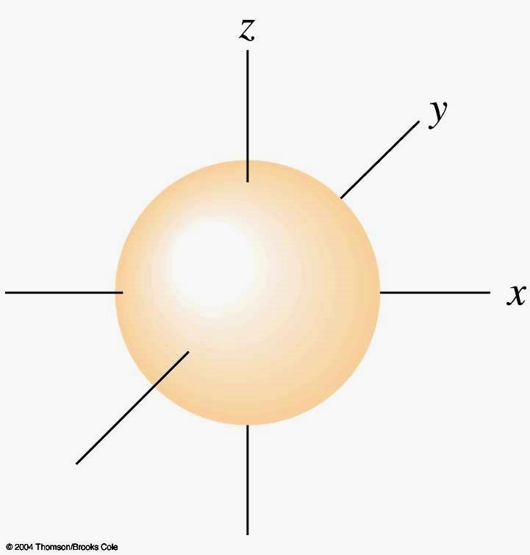
Atomic Orbitals
Atomic orbitals are regions of space where the probability of finding an electron about an atom is highest.
s orbital properties:
There is one s orbital per n level.
l = 0 1 value of m_{l}
s orbitals are spherically symmetric.
Figure 2 s orbital

Slide 17
Orbitals: Shapes and Sizes
s orbitals are spherical in shape and get increasingly larger with every principal energy level.
As principal energy level number increases, so does the probability of finding an electron further from the nucleus.
Figure 3: The relative sizes of the
spherical 1s, 2s, and 3s orbitals of hydrogen

Slide 18
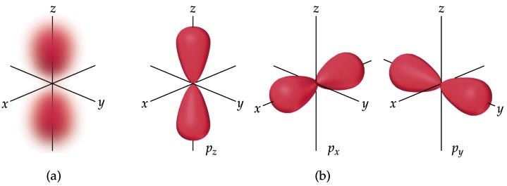
Atomic Orbitals
Principal energy level 2 has 2 sublevels, 2s and 2p.
p orbitals are dumbbell shaped and, based on probability calculations, have three different orientations.

Slide 19
The 3p, 4p, 5p…orbitals have the same shape, but are larger and further away from the nucleus. Same trend as s orbitals.
p orbital properties:
The first p orbitals appear in the n = 2 shell.
p orbitals are peanut or dumbbell shaped volumes.
They are directed along the axis of a Cartesian coordinate system.
There are 3 p orbitals per n level.
The three orbitals are named p_{x}, p_{y}, p_{z}.
They have an l = 1.
m_{l} = -1,0,+1 3 values of m_{l}

Slide 20
Figure 4: A diagram of principal energy levels 1 and 2 showing the shapes of orbitals that compose the sublevels

Slide 21
d orbital properties:
The first d orbitals appear in the n = 3 shell.
The five d orbitals have two different shapes:
- 4 are clover leaf shaped.
1 is peanut shaped with a doughnut around it.
The orbitals lie directly on the Cartesian axes or are rotated 45º from the axes.
There are 5 d orbitals per n level.
The five orbitals are named dxy, dyz, dxz, dx²-y² , dz²
They have an l = 2.
m_{l} = -2, -1, 0, +1, +2 (5 values of m _{l} )

Slide 22
Figure 5: d orbital shapes

Slide 23
f orbital properties:
The first f orbitals appear in the n = 4 shell.
The f orbitals have the most complex shapes.
There are seven f orbitals per n level.
The f orbitals have complicated names.
They have an l = 3
m_{l} = -3,-2,-1,0,+1,+2, +3 7 values of m_{l}
The f orbitals have important effects in the lanthanide

Slide 24
Figure 6: f orbital shapes

Slide 25
Subshells and Orbitals
the subshells of a principal shell have slightly different energies.
the subshells in a shell of H all have the same energy, but for multielectron atoms the subshells have different energies.
s < p < d < f
each subshell contains one or more orbitals
s subshells have 1 orbital
p subshells have 3 orbitals
d subshells have 5 orbitals
f subshells have 7 orbitals

Slide 26
Orbitals, Sublevels & Electrons
for a many electron atom, build-up the energy levels, filling each orbital in succession by energy
ground state
1s < 2s < 2p < 3s < 3p < 4s < 3d < 4p < 5s < 4d < 5p
< 6s < 4f < 5d < 6p < 7s < 5f < 6d < 7p.
degenerate orbitals are orbitals with the same energy.
each p sublevel has 3 degenerate p orbitals
each d sublevel has 5 degenerate d orbitals
each f sublevel has 7 degenerate f orbitals

Slide 27
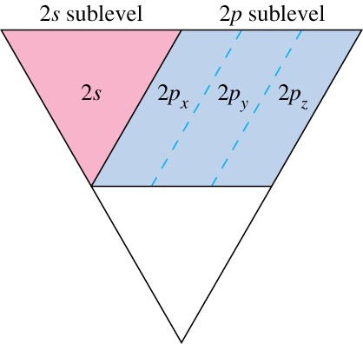
Figure7: Principal levels can be divided into sublevels
Figure 8: Principal level 2 shown divided into the 2s and 2p sublevels

Slide 28
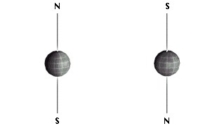
Paramagnetism and Diamagnetism
Unpaired electrons have their spins aligned or
This increases the magnetic field of the atom.
Atoms with unpaired electrons are called paramagnetic.
Paramagnetic atoms are attracted to a magnet.
Diamagnetism Paired electrons have their spins unaligned
Paired electrons have no net magnetic field.
Atoms with unpaired electrons are called diamagnetic.
Diamagnetic atoms are repelled by a magnet.

Slide 29
The number of orbitals per n level is given by n². The maximum number of electrons per n level is 2n². The value is 2n² because of the two paired electrons.
n n² 2n²
1 1 2 n = Energy level
2 4 8 n²= no. of orbital
3 9 18 2n²= Max no. of electrons
4 16 32

Slide 30
Pauli exclusion principle
Pauli exclusion principle states that no two electrons in an atom can have the same set of 4 quantum numbers.
Thus, a given orbital can hold a maximum of 2 electrons of opposite spin.
No orbital may have more than 2 electrons.
Electrons in the same orbital must have opposite spins.
s sublevel holds 2 electrons
p sublevel holds 6 electrons
d sublevel holds 10 electrons
f sublevel holds 14 electrons
The Aufbau Principle
Electrons always enter the lowest energy orbital.

Slide 31
Electron configuration
the distribution of electrons into the various energy shells and subshells in an atom in its ground state is called its electron configuration.
each energy shell and subshell has a maximum number of electrons it can hold
s = 2, p = 6, d = 10, f = 14
we place electrons in the energy shells and subshells in order of energy, from low energy up
(Aufbau Principal).
Filling an Orbital with Electrons
each orbital may have a maximum of 2 electrons (Pauli Exclusion Principle).
electrons spin on an axis (generating their own magnetic field).
when two electrons are in the same orbital, they must have opposite spins (so there magnetic fields will cancel).

Slide 32
Orbital Diagrams
we often represent an orbital as a square and the electrons in that orbital as arrows.
the direction of the arrow represents the spin of the electron
unoccupied orbital orbital with 1 electron orbital with 2 electrons

Slide 33
Filling the Orbitals in a Subshell with Electrons
energy shells fill from lowest energy to high  subshells fill from lowest energy to high
s → p → d → f
orbitals that are in the same subshell have the same energy
when filling orbitals that have the same energy, place one electron in each before completing pairs
Hund’s Rule
The Aufbau Principle describes the electron filling order in atoms.

Slide 35
Order of Subshell Filling in Ground State Electron Configurations
1
s
2
s
2
p
3
s
3
p
3
d
4
s
4
p
4
d
4
f
5
s
5
p
5
d
5
f
6
s
6
p
6
d
7
s

Slide 36
Or you can use the periodic chart .

Slide 37
A box diagram showing the order in which orbitals fill to produce the atoms in the periodic table
produce the atoms in the periodic table

Slide 38
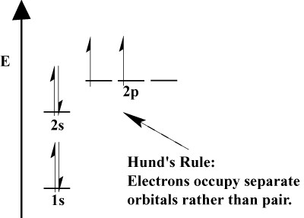
Hund’s Rule
for a set of degenerate orbitals, half fill each orbital first before pairing
highest energy level called the valence shell
electrons in the valence shell called valence electrons
electrons not in the valence shell are called core electrons
often use symbol of previous noble gas to represent core
electrons
1s²2s²2p⁶ = [Ne]
The orbitals of a given sublevel (e.g. p, or d, or f) are degenerate (of the same energy).
The lowest energy state occurs with the maximum number of unpaired electrons.
Electrons enter an empty orbital of a given sublevel before pairing up.

Slide 39
Lowest energy is determined by the n + l rule. That is, the sum of those two quantum numbers determines the lowest energy, the lower the sum the lower the energy. If the sums are equal, the lowest value of n determines the lowest energy.
n |  | l
1 | + | 0 | = | 1 | 1s
2 | + | 0 | = | 2 | 2s
2 | + | 1 | = | 3 | 2p
3 | + | 0 | = | 3 | 3s

Slide 40
there is a tie, the 2p is lower than the 3s because n=2 is less than n=3
There are 2 ties, the 4s is higher than the 3p because
n=4 is GREATER than n=3 and the 4s (sum = 4)
comes before the 3d (sum = 5).
The second tie is 5; 3d comes before 4p because
______.
n |  | l
3 | + | 1 | = | 4 | 3p
3 | + | 2 | = | 5 | 3d
4 | + | 0 | = | 4 | 4s
4 | + | 1 | = | 5 | 4p

Slide 41
Electron Configuration of Atoms in their Ground State
the electron configuration is a listing of the subshells in order of filling with the number of electrons in that subshell written as a superscript
Kr = 36 electrons = 1s²2s²2p⁶3s²3p⁶4s²3d¹⁰4p⁶
a shorthand way of writing an electron configuration is to use the symbol of the previous noble gas in [] to represent all the inner electrons, then just write the last set
Rb = 37 electrons = 1s²2s²2p⁶3s²3p⁶4s²3d¹⁰4p⁶5s¹ = [Kr]5s¹

Slide 42
Example – Write the Ground State Orbital Diagram and Electron Configuration of Magnesium.
1. Determine the atomic number of the element from the Periodic Table
This gives the number of protons and electrons in the atom
Mg Z = 12, so Mg has 12 protons and 12 electrons
Filling of orbitals for elements Z = 1 to 18 (H to Ar)

Slide 43
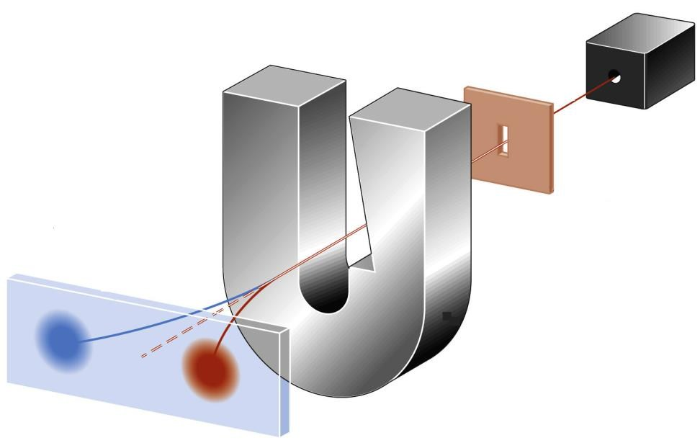
Hydrogen = 1 electron.
1
s

Slide 44
Helium = 2 electrons
Lithium = 3 electrons
Beryllium = 4 electrons
1s 2s
The s orbitals can only ever hold two electrons.
The first principal energy level gets filled before the second.
1s² is very stable since it is a filled sublevel. The same is true for 2s².

Slide 45
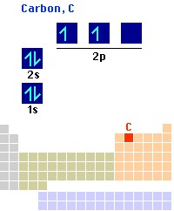
The p-orbitals are equivalent in energy. However, electrons are placed singly into each orbital to minimize spin repulsion. (Consider people sitting at tables in a cafeteria).

Slide 46
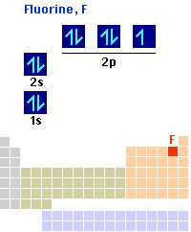
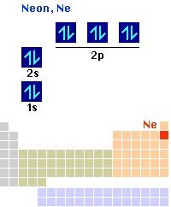

Slide 47
Filled 1st and 2nd primary energy levels.
Filled p orbitals result in a very stable electron configuration.
This explains why certain elements form the ions they do.
19K 1s²2s²2p⁶3s²3p⁶4s¹
20Ca 1s²2s²2p⁶3s²3p⁶4s²
21Sc 1s²2s²2p⁶3s²3p⁶4s²3d¹
22Ti 1s²2s²2p⁶3s²3p⁶4s²3d²
23V 1s²2s²2p⁶3s²3p⁶4s²3d³

Slide 48
24Cr 1s²2s²2p⁶3s²3p⁶4s¹3d⁵
There is a tendency toward half-filled and completely filled d subshells. This is a consequence of the closeness of the 3d and the 4s orbital energies.
The 3d level becomes more stable as we move from left to right on the periodic chart. Remember there is an increase in the number of __________consequently, an increase in the number of electrons as we move from left to right on the chart.
25Mn 1s²2s²2p⁶3s²3p⁶4s²3d⁵
26Fe 1s²2s²2p⁶3s²3p⁶4s²3d⁶
27Co 1s²2s²2p⁶3s²3p⁶4s²3d⁷

Slide 49
28Ni 1s²2s²2p⁶3s²3p⁶4s²3d⁸
29Cu 1s²2s²2p⁶3s²3p⁶4s¹3d¹⁰
Additional exceptions are Mo 5s¹4d⁵; Ag 5s¹4d¹⁰; Au 6s¹5d¹⁰ That is reasonable considering their position on the periodic chart.

Slide 50
30Zn 1s²2s²2p⁶3s²3p⁶4s²3d¹⁰
31Ga 1s²2s²2p⁶3s²3p⁶4s²3d¹⁰4p¹
32Ge 1s² 2s²2p⁶3s²3p⁶4s²3d¹⁰4p²
33As 1s² 2s²2p⁶3s²3p⁶4s²3d¹⁰4p³
34Se 1s²2s²2p⁶3s²3p⁶4s²3d¹⁰4p⁴
35Br 1s²2s²2p⁶3s²3p⁶4s²3d¹⁰4p⁵
36Kr 1s²2s²2p⁶3s²3p⁶4s²3d¹⁰4p⁶

Slide 51
Example – Write the Ground State Orbital Diagram and Electron
Configuration of Magnesium.
Draw 9 boxes to represent the first 3 energy levels s and p orbitals
1s 2s 2p 3s 3p
Example – Write the Ground State Orbital Diagram and
Electron Configuration of Magnesium.
Add one electron to each box in a set, then pair the electrons before
going to the next set until you use all the electrons
• When pair, put in opposite arrows

Slide 52
Add one electron to each box in a set, then pair the electrons before going to the next set until you use all the electrons
When pair, put in opposite arrows
Example – Write the Ground State Orbital Diagram and Electron Configuration of Magnesium.
Use the diagram to write the electron configuration
Write the number of electrons in each set as a superscript next to the name of the orbital set 1s²2s²2p⁶3s² = [Ne]3s²

Slide 53
Valence Electrons
the electrons in all the subshells with the highest principal energy shell are called the valence electrons.
electrons in lower energy shells are called core electrons.
chemists have observed that one of the most important factors in the way an atom behaves, both chemically and physically, is the number of valence electrons.

Slide 54
Rb = 37 electrons = 1s²2s²2p⁶3s²3p⁶4s²3d¹⁰4p⁶5s¹
the highest principal energy shell of Rb that contains electrons is the 5th, therefore Rb has 1 valence electron and 36 core electrons.
Kr = 36 electrons = 1s²2s²2p⁶3s²3p⁶4s²3d¹⁰4p⁶
the highest principal energy shell of Kr that contains electrons is the 4th, therefore Kr has 8 valence electrons and 28 core electrons
Electron Configuration
Elements in the same column on the Periodic Table have
Similar chemical and physical properties
Similar valence shell electron configurations
Same numbers of valence electrons
Same orbital types
Different energy levels

Slide 56
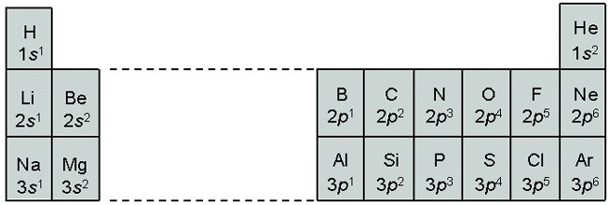
The Modern Periodic Table
Columns are called Groups or Families  Rows are called Periods
Each period shows the pattern of properties repeated in the next period
Main Groups = Representative Elements
Transition Elements
Bottom rows = Lanthanides and Actinides
really belong in Period 6 & 7

Slide 57
Figure: Partial electron configurations for the elements potassium through krypton

Slide 58
Figure : The orbitals being filled for elements in various parts of the periodic table

Slide 59
Synthesis Question
What is the atomic number of the element that should theoretically be the noble gas below Rn?
The 6 d’s are completed with element 112 and the 7p’s are completed with element 118. Thus the next noble gas (or perhaps it will be a noble liquid) should be element 118.
Group Question
 In a universe different from ours, the laws of quantum mechanics are the same as ours with one small change. Electrons in this universe have three spin states, -1, 0, and +1, rather than the two, +1/2 and -1/2, that we have. What two elements in this universe would be the first and second noble gases? (Assume that the elements in this different universe have the same symbols as in ours.)

Slide 60
End of Chapter 5
The study of various spectra is one of the fundamental tools that chemists apply to numerous areas of their work.

